Slide 1
Unit 3 Basics of IT

Slide 2
4. Relational Model:
It is the current favorite model.
The relational model is a lower level model that uses a collection of tables to represent both data and relationships among those data.
Each table has multiple columns, and each column has a unique name.
Each table corresponds to an entity set or relationship set, and each row represents an instance of that entity set or relationship set.
Structured query language (SQL) is used to manipulate data stored in tables.

Slide 3
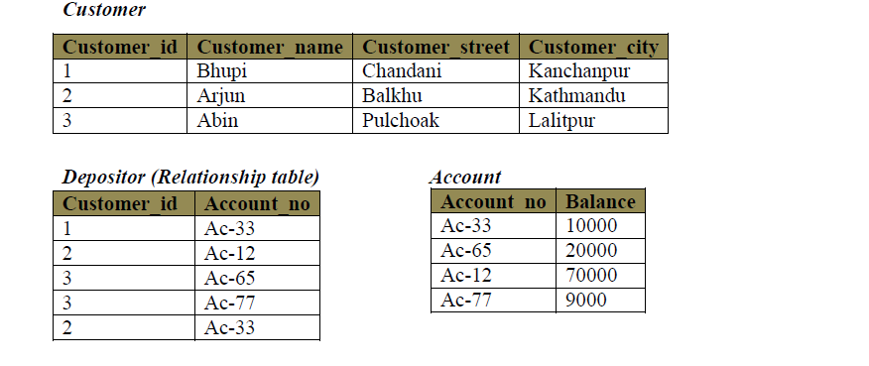

Slide 4
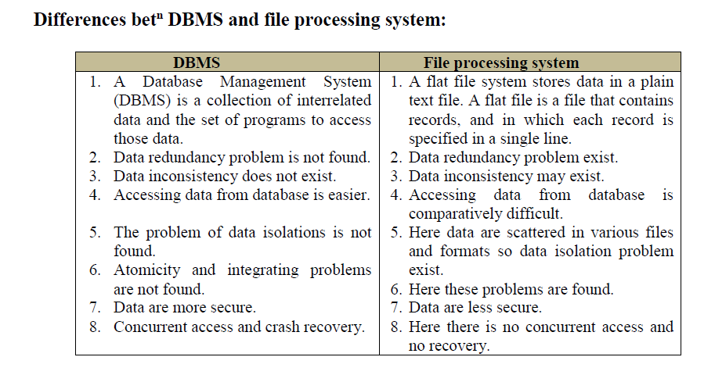

Slide 5
Data Warehouse
A data warehouse is a large collection of business data used to help an organization make decisions.
The concept of the data warehouse has existed since the 1980s.
The large amount of data in data warehouses comes from different places such as internal applications like marketing, sales, and finance; customer-facing apps; and external partner systems.

Slide 6
On a technical level, a data warehouse periodically pulls data from those apps and systems; then, the data goes through formatting and import processes to match the data already in the warehouse.
The data warehouse stores this processed data so it’s ready for decision makers to access.
How frequently data pulls occur, or how data is formatted, etc., will vary depending on the needs of the organization

Slide 7
Better data — Adding data sources to a data warehouse enables organizations to ensure that they are collecting consistent and relevant data from that source.
Faster decisions — Data in a warehouse is in such consistent formats that it is ready to be analyzed. It also provides the analytical power and a more complete dataset to base decisions on hard facts.

Slide 8
Big Data Introduction
Big data is a collection of massive and complex data sets and data volume that include the huge quantities of data, data management capabilities, social media analytics and real-time data.
Big data is about data volume and large data set's measured in terms of terabytes or petabytes (1024 TB). This phenomenon is called Big data.

Slide 9
Big Data Examples
The New York Stock Exchange is an example of Big Data that generates about one terabyte of new trade data per day.
The statistic shows that 500+terabytes of new data get ingested into the databases of social media site Facebook, every day. This data is mainly generated in terms of photo and video uploads, message exchanges, putting comments etc.
A single Jet engine can generate 10+terabytes of data in 30 minutes of flight time. With many thousand flights per day, generation of data reaches up to many Petabytes.

Slide 10
Characteristics Of Big Data
Big data can be described by the following characteristics:
Volume
Variety
Velocity
Variability

Slide 11
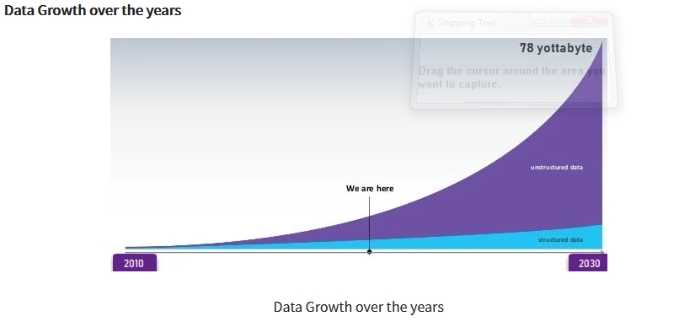

Slide 12
Types Of Big Data
Following are the types of Big Data:
Structured
Unstructured
Semi-structured

